Slide 1
Diabetes Onset Prediction

Slide 2
INTRODUCTION
Diabetes mellitus (DM), commonly referred to as diabetes, is a group of metabolic disorders in which there are high blood sugar levels over a prolonged period. Symptoms of high blood sugar include frequent urination, increased thirst, and increased hunger. If left untreated, diabetes can cause many complications. Acute complications can include diabetic ketoacidosis , hyperosmolar hyperglycemic state, or death. Serious long-term complications include cardiovascular disease, stroke, chronic kidney disease, foot ulcers, and damage to the eyes.

Slide 3
Predict the Onset of Diabetes
Data mining and machine learning is helping medical professionals make diagnosis easier by bridging the gap between huge data sets and human knowledge. We can begin to apply machine learning techniques for classification in a dataset that describes a population that is under a high risk of the onset of diabetes.

Slide 4
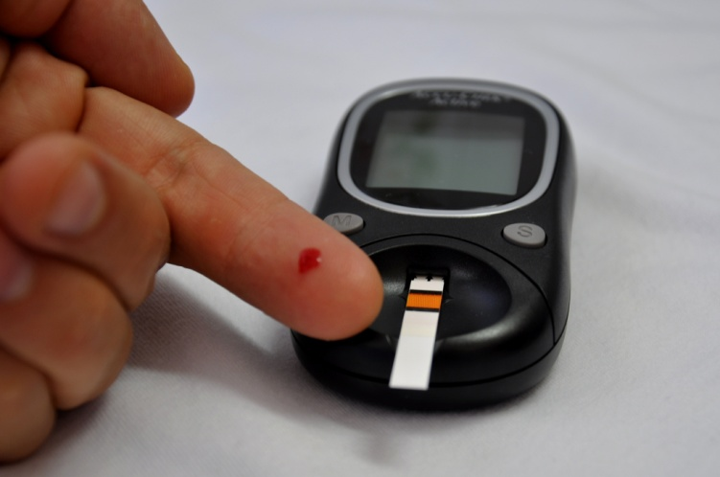
For the purposes of this dataset, diabetes was diagnosed according to World Health Organization Criteria, which stated that if the 2 hour post-load glucose was at least 200 mg/dl at any survey exam or if the Indian Health Service Hospital serving the community found a glucose concentration of at least 200 mg/dl during the course of routine medical care.
Given the medical data we can gather about people, we should be able to make better predictions on how likely a person is to suffer the onset of diabetes, and therefore act appropriately to help. We can start analyzing data and experimenting with algorithms that will help us study the onset of diabetes in Pima Indians.

Slide 5
Parameters
We can learn from the data found on UCI Machine Learning Repository which contains data on female patients at least 21 years old of Pima Indian heritage.
We have 768 instances and the following 8 attributes:
Number of times pregnant (preg)
Plasma glucose concentration a 2 hours in an oral glucose tolerance test (plas)
Diastolic blood pressure in mm Hg (pres)
Triceps skin fold thickness in mm (skin)
2-Hour serum insulin in mu U/ml (insu)
Body mass index measured as weight in kg/(height in m)^2 (mass)
Diabetes pedigree function (pedi)
Age in years (age)

Slide 6
DPF(Diabetes Pedigree Function)
It provided some data on diabetes mellitus history in relatives and the genetic relationship of those relatives to the patient. This measure of genetic influence gave us an idea of the hereditary risk one might have with the onset of diabetes mellitus. Based on observations in the proceeding section, it is uncovered how well this function predicts the onset of diabetes.

Slide 7
Observations from Data
Based on look up at first 10 columns of data we know that :
The preg and age attributes are integers.
The population is generally young, less than 50 years old.
Some attributes where a zero value exist seem to be errors in the data (e.g. plas, pres, skin, insu, and mass).
This data shall be either removed or handled carefully.

Slide 8
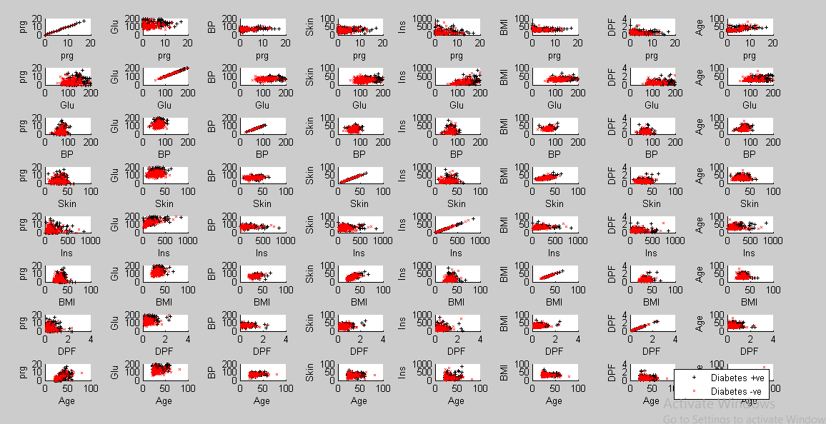
Scatter plot

Slide 9
Observations from scatter plot
Reviewing scatter plots of all attributes in the dataset shows that:
There is no obvious relationship between age and onset of diabetes.
There is no obvious relationship between pedi function and onset of diabetes.
This may suggest that diabetes is not hereditary, or that the Diabetes Pedigree Function needs work.
Larger values of plas combined with larger values for age, pedi, mass, insu, skin, pres, and preg tends to show greater likelihood of testing positive for diabetes.

Slide 10
Method
Initialize theta vector to zero , X matrix to input data and y vector to output data.
Plot data with a scatter plot w.r.t all parameters.
Check cost and gradient using initialized theta and random theta.
Then optimize theta using built in fminunc function such that cost function is minimized.
Find cost function and gradient using the optimized theta.
Sigmoid function (1/(1+e^(-h))) where h is hypothesis function.
Find sigmoid of product of test data and theta to get probability of diabetes.
If probability is greater than 0.5 ,predict 1 otherwise predict 0
Test the obtained theta using accuracy of obtained theta.

Slide 11
Conclusion
In this project , we paid close attention to logistic regression and observed its performance through various metrics.
This work gave me a better understanding of machine learning applications in medical diagnosis.
This is also focused on data transforms and algorithm analysis.
I believe that this is good start for building methods that help predicting the onset of diabetes.

Slide 12
THANK YOU

